Slide 1

S
Q
L
NOBLE SCHOOL

Slide 2
S
Q
L
NOBLE_SCHOOL DATABASE
Create a database for the NOBLE SCHOOL to store the information of students, staff, subjects, classes, parents etc
QUERY :
CREATE DATABASE NOBLE_SCHOOL;
Use the database NOBLE_SCHOOL for creating the tables.
QUERY :
USE NOBLE_SCHOOL;

Slide 3
S
Q
L
NOBLE_SCHOOL DATABASE
Creating the tables in the database.
Inserting values to the tables.
Retrieving the datas from the table.

Slide 4
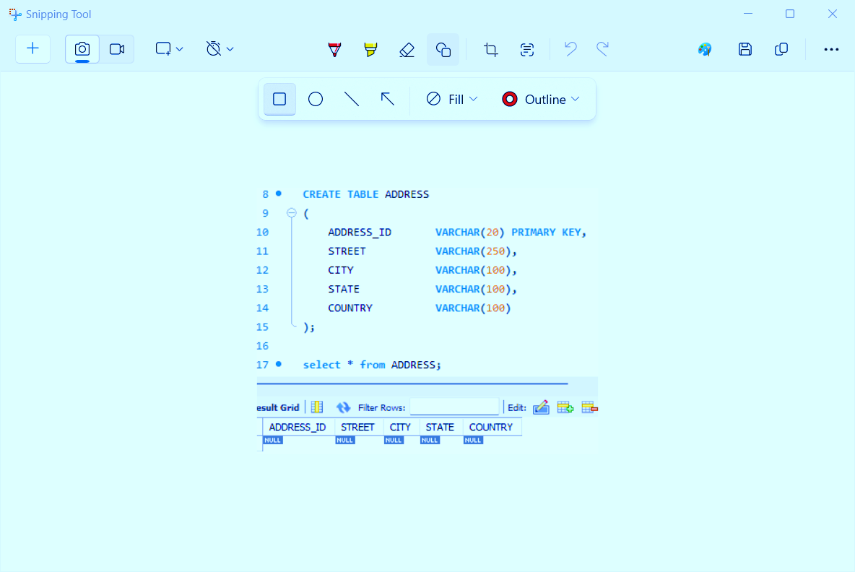
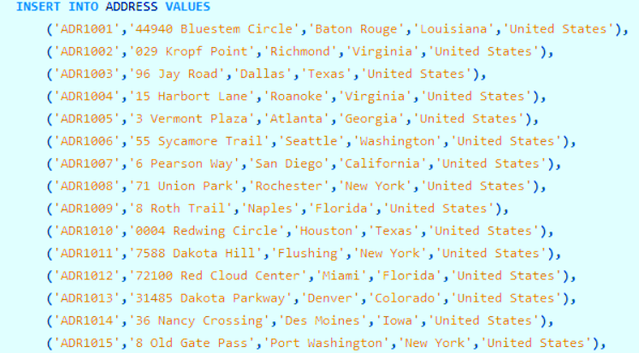
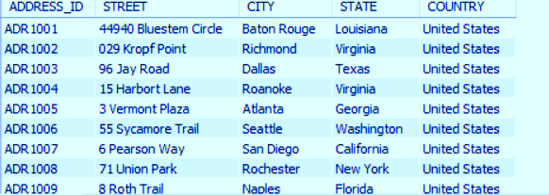
S
Q
L
ADDRESS - TABLE
# Columns : 5
# Values : 1000
Table Creation
Inserting values into table
SELECT * FROM ADDRESS;

Slide 5
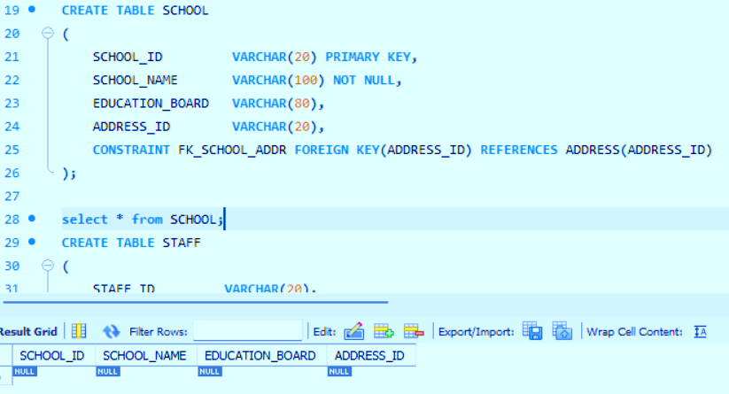

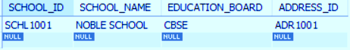
S
Q
L
SCHOOL - TABLE
# Columns : 4
# Values : 1
Table Creation
Inserting values into table
SELECT * FROM SCHOOL;

Slide 6
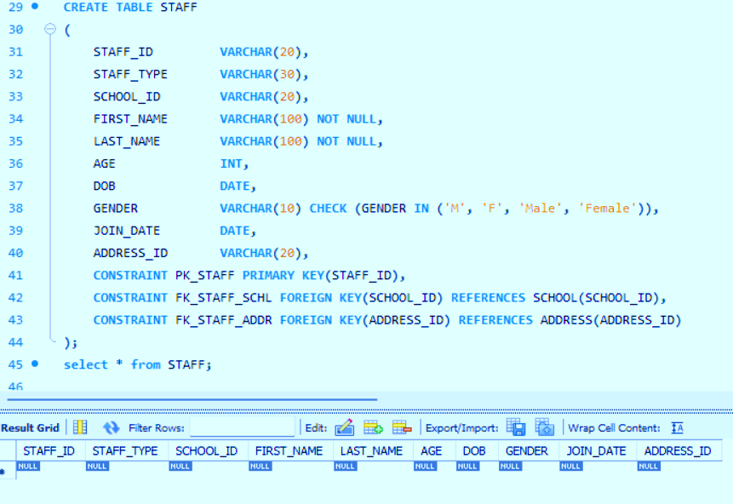
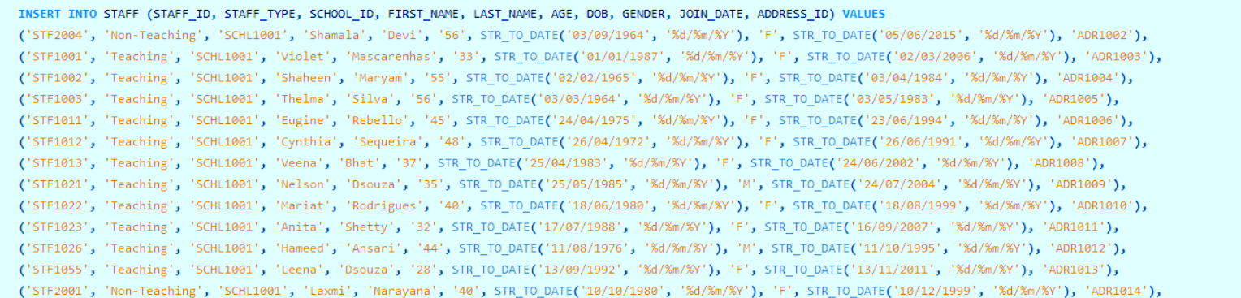
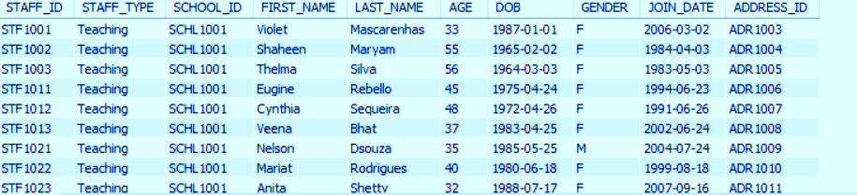
S
Q
L
STAFF - TABLE
# Columns : 10
# Values : 23
Table Creation
Inserting values into table
SELECT * FROM STAFF;

Slide 7
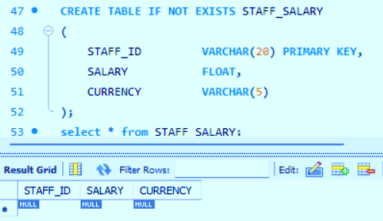
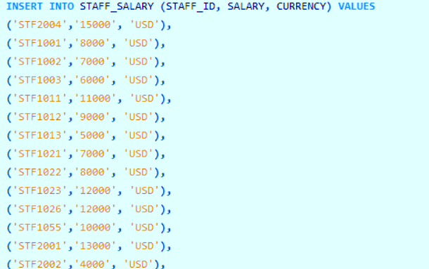
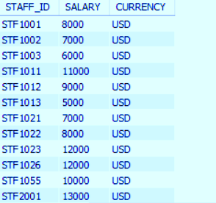
S
Q
L
STAFF_SALARY - TABLE
# Columns : 3
# Values : 24
Table Creation
Inserting values into table
SELECT * FROM STAFF_SALARY;

Slide 8
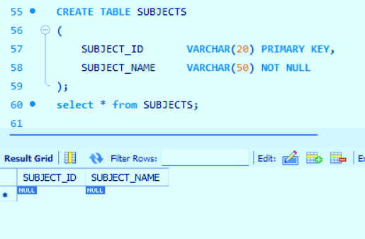
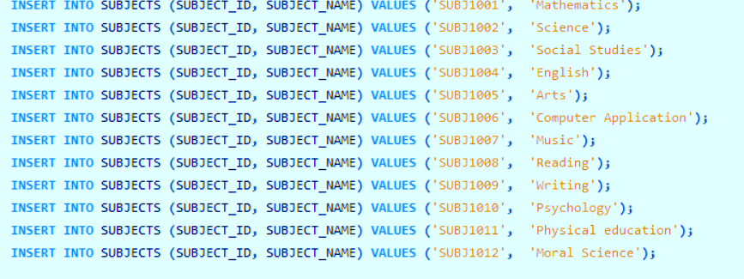
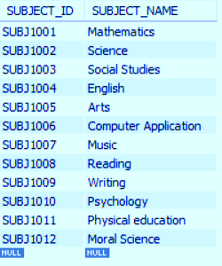
S
Q
L
SUBJECTS - TABLE
# Columns : 2
# Values : 12
Table Creation
Inserting values into table
SELECT * FROM SUBJECTS ;

Slide 9
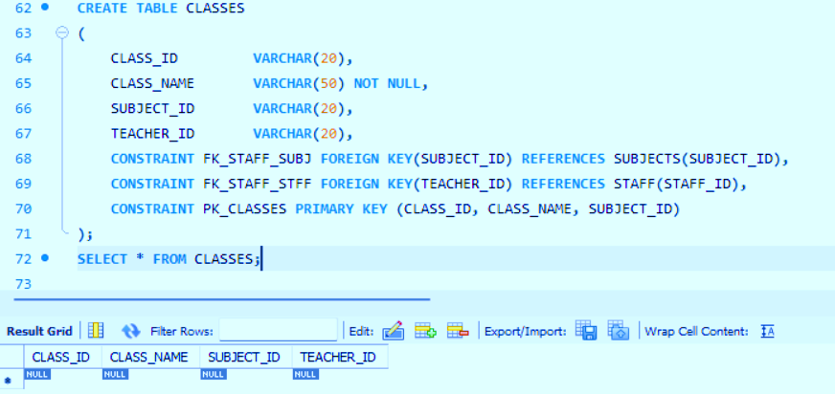
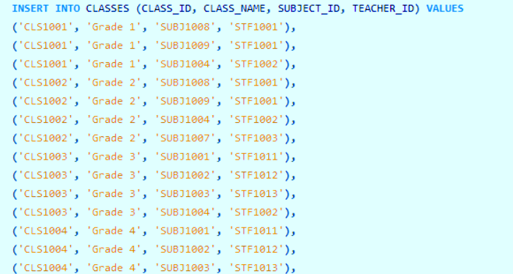
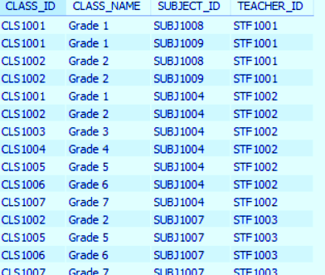
S
Q
L
CLASSES - TABLE
# Columns : 4
# Values : 51
Table Creation
Inserting values into table
SELECT * FROM CLASSES ;

Slide 10
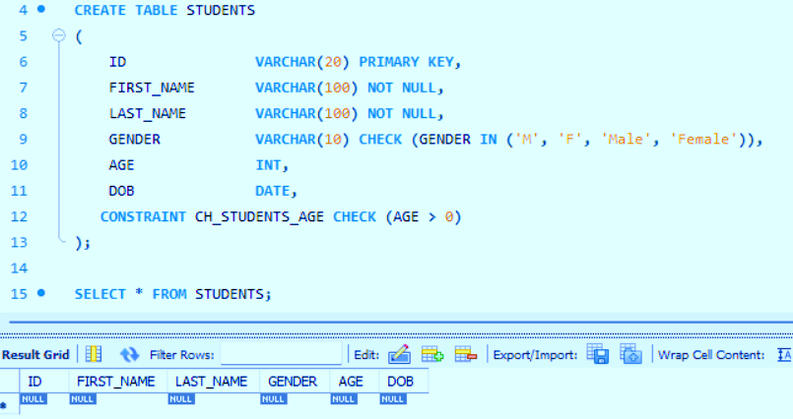
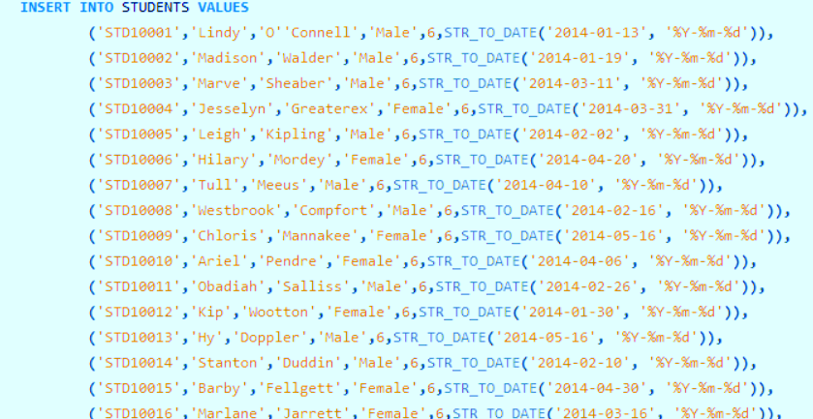
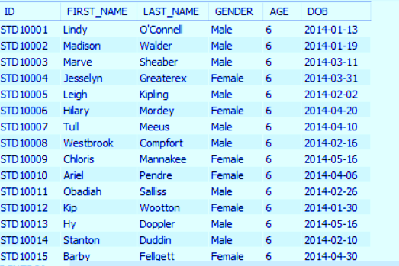
S
Q
L
STUDENTS - TABLE
# Columns : 8
# Values : 1000
Table Creation
Inserting values into table
SELECT * FROM STUDENTS ;

Slide 11
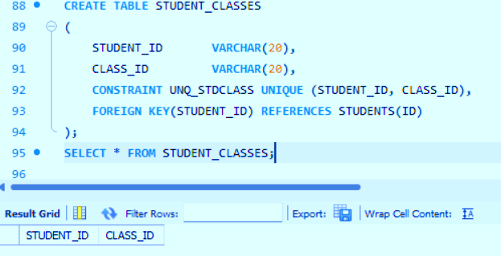
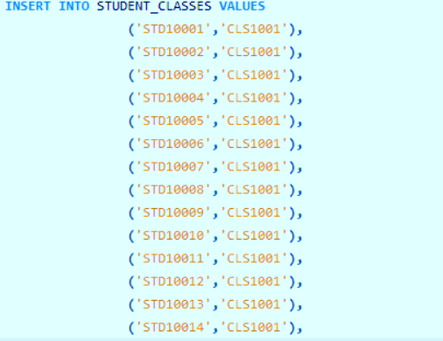
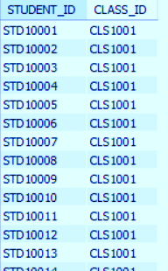
S
Q
L
STUDENT_CLASSES - TABLE
# Columns : 2
# Values : 1000
Table Creation
Inserting values into table
SELECT * FROM STUDENT_CLASSES ;

Slide 12
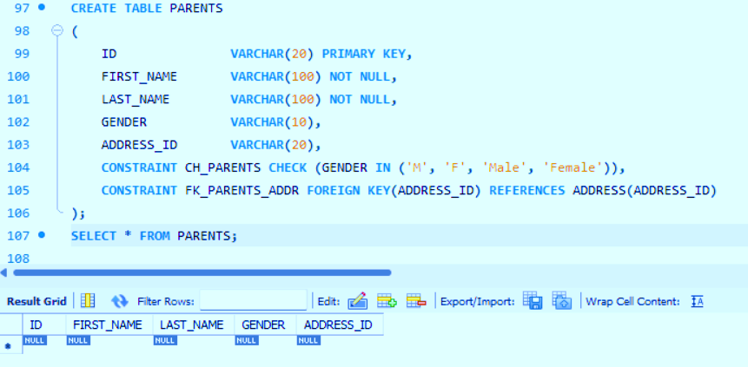
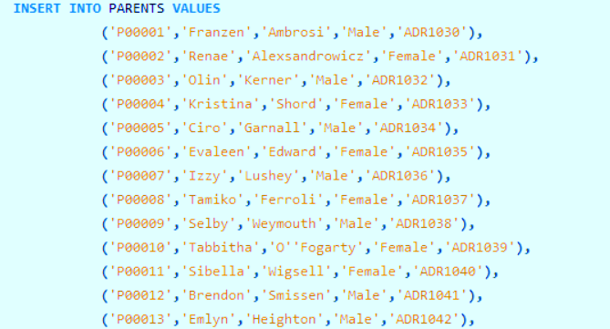
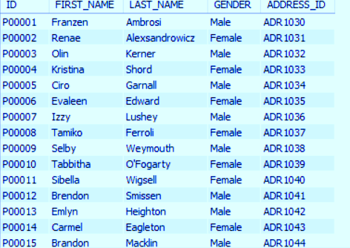
S
Q
L
PARENTS - TABLE
# Columns : 5
# Values : 971
Table Creation
Inserting values into table
SELECT * FROM PARENTS;

Slide 13
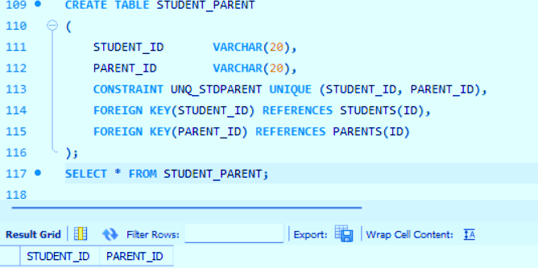
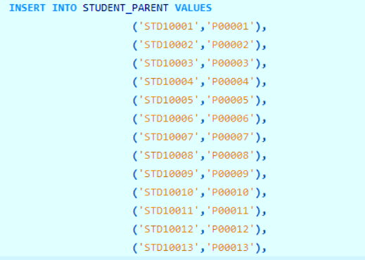
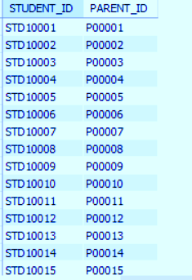
S
Q
L
STUDENT_PARENT - TABLE
# Columns : 2
# Values : 1000
Table Creation
Inserting values into table
SELECT * FROM STUDENT_PARENT;

Slide 14
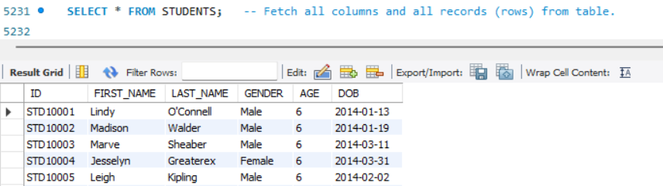
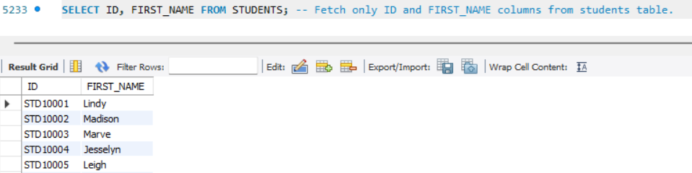
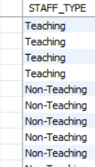
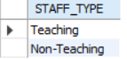
S
Q
L
BASIC QUERIES
1. Fetch all columns and records from STUDENTS table
2. Fetch only ID and FIRST_NAME from STUDENTS table
SELECT * FROM STUDENTS;
SELECT ID, FIRST_NAME FROM STUDENTS;
3. Fetch STAFF_TYPE column from STAFF table
4. Fetch unique STAFF_TYPE value from STAFF table
SELECT STAFF_TYPE FROM STAFF ;
SELECT DISTINCT STAFF_TYPE FROM STAFF ;

Slide 15
S
Q
L
SQL OPERATORS

Slide 16
S
Q
L
COMPARISON OPERATORS
Comparison operators in SQL are used to compare two expressions and return a Boolean value (TRUE, FALSE, or NULL) based on the result of the comparison. These operators are commonly used in SQL queries to filter data based on specific conditions. Here are the main comparison operators in SQL,
Equal to (=) : Checks if two values are equal.
Not equal to (<> or !=) : Checks if two values are not equal.
Greater than (>) : Checks if the value on the left is greater than the value on the right.
Less than (<) : Checks if the value on the left is less than the value on the right.
Greater than or equal to (>=) : Checks if the value on the left is greater than or equal to the value on the right.
Less than or equal to (<=) : Checks if the value on the left is less than or equal to the value on the right.
BETWEEN : Checks if a value is within a range (inclusive).
IN : Checks if a value matches any value in a list.
LIKE : Checks if a value matches a pattern.
IS NULL : Checks if a value is NULL.
IS NOT NULL : Checks if a value is not NULL.
Comparison operators are essential tools for PROBLEMing and managing data in SQL databases, allowing for precise and flexible data retrieval based on specific criteria.

Slide 17
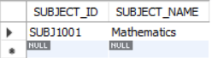
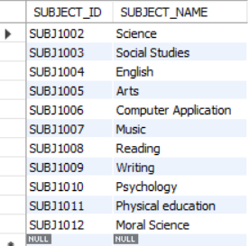
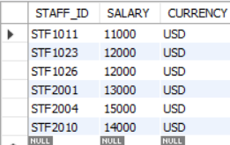
S
Q
L
COMPARISON OPERATORS
PROBLEM
QUERY
RESULT TABLE
1 . Fetch all records where subject name
is Mathematics from SUBJECTS
table
SELECT * FROM SUBJECTS WHERE
SUBJECT_NAME = 'Mathematics';
2. Fetch all records where subject name
is not Mathematics from SUBJECTS
table.
SELECT * FROM SUBJECTS WHERE
SUBJECT_NAME <> 'Mathematics';
3. Fetch all records where salary is
greater than 10000 from
STAFF_SALARY table.
SELECT * FROM STAFF_SALARY
WHERE SALARY > 10000;

Slide 18
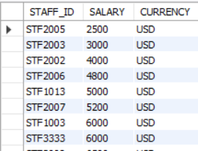
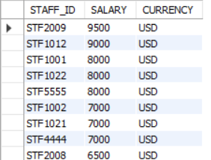
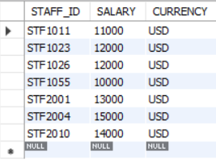
S
Q
L
COMPARISON OPERATORS
PROBLEM
QUERY
RESULT TABLE
4 . Fetch all records where salary is
less than 10000 and the output is
sorted in ascending order of salary
from STAFF_SALARY table.
SELECT * FROM STAFF_SALARY WHERE SALARY < 10000 ORDER BY SALARY;
5. Fetch all records where salary is less
than 10000 and the output is sorted in
descending order of salary from
STAFF_SALARY table.
SELECT * FROM STAFF_SALARY
WHERE SALARY < 10000 ORDER BY
SALARY DESC;
6. Fetch all records where salary is
greater than or equal to 10000.
SELECT * FROM STAFF_SALARY WHERE SALARY >= 10000;

Slide 19
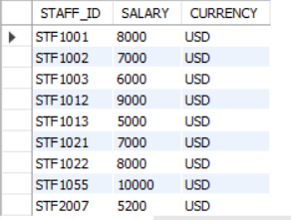
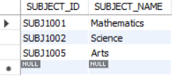
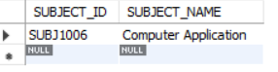
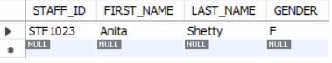
S
Q
L
COMPARISON OPERATORS
PROBLEM
QUERY
RESULT TABLE
7. Fetch all records where salary is between 5000 and 10000 from STAFF_SALARY table.
SELECT * FROM STAFF_SALARY WHERE SALARY BETWEEN 5000 AND 10000;
8. Fetch all records where subjects is either Mathematics, Science or Arts from SUBJECTS table.
SELECT * FROM SUBJECTS WHERE SUBJECT_NAME IN ('Mathematics', 'Science', 'Arts’);
9.Fetch records from SUBJECTS table where subject name has Computer as prefixed.
SELECT * FROM SUBJECTS WHERE SUBJECT_NAME LIKE 'Computer%';.
10. Fetch STAFF_ID, FIRST_NAME, LAST_NAME , GENDER FROM STAFF where first name of staff starts with "A" AND last name starts with "S".
SELECT STAFF_ID, FIRST_NAME, LAST_NAME , GENDER FROM STAFF WHERE FIRST_NAME LIKE 'A%' AND LAST_NAME LIKE 'S%';

Slide 20
S
Q
L
LOGICAL OPERATORS
Logical operators in SQL are used to combine multiple conditions in a SQL statement's WHERE clause. They help refine the selection criteria for queries, allowing more complex and specific data retrieval. The primary logical operators in SQL are
AND : Combines two or more conditions and returns true only if all the conditions are true.
OR : Combines two or more conditions and returns true if at least one of the conditions is true.
NOT : Reverses the result of a condition. It returns true if the condition is false, and vice versa.
Logical operators are crucial for creating sophisticated queries in SQL, allowing you to filter and retrieve data based on multiple, specific conditions. They enable the development of powerful, detailed, and precise data retrieval strategies.

Slide 21
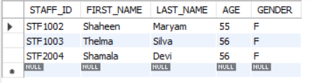
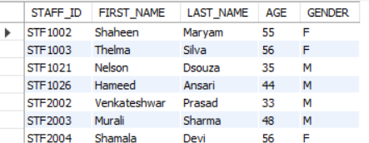
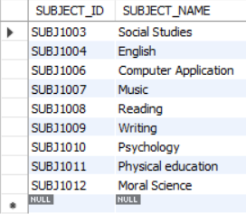
S
Q
L
LOGICAL OPERATORS
PROBLEM
QUERY
RESULT TABLE
1. Fetch STAFF_ID, FIRST_NAME, LAST_NAME ,AGE, GENDER from STAFF table where staff is female and is over 50 years of age.
SELECT STAFF_ID, FIRST_NAME, LAST_NAME ,AGE, GENDER FROM STAFF WHERE AGE > 50 AND GENDER = 'F';
2. Fetch STAFF_ID, FIRST_NAME, LAST_NAME ,AGE, GENDER from STAFF table where staff is male or is over 50 years of age.
SELECT STAFF_ID, FIRST_NAME, LAST_NAME ,AGE, GENDER FROM STAFF WHERE AGE > 50 OR GENDER = 'M';
3. Fetch all records where subjects is not Mathematics, Science or Arts from SUBJECTS table.
SELECT * FROM SUBJECTS WHERE SUBJECT_NAME NOT IN ('Mathematics', 'Science', 'Arts');

Slide 22
S
Q
L
ARITHMETIC OPERATORS
Arithmetic operators in SQL are used to perform mathematical operations on numerical data. These operators allow you to execute calculations directly within your SQL queries, facilitating tasks like summing values, computing averages, and more. The primary arithmetic operators in SQL are :
Addition (+) : Adds two numerical values.
Subtraction (-) : Subtracts one numerical value from another.
Multiplication (*) : Multiplies two numerical values.
Division (/) : Divides one numerical value by another.
Modulus (%) : Returns the remainder of one numerical value divided by another.
Arithmetic operators are essential tools in SQL for performing calculations directly within your queries, allowing for real-time data analysis and reporting. They enhance the flexibility and power of SQL in managing and manipulating numerical data.

Slide 23
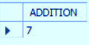
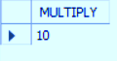
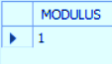
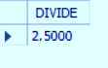
S
Q
L
ARITHMETIC OPERATORS
PROBLEM
QUERY
RESULT TABLE
1. Add 2 numbers
SELECT (5+2) AS ADDITION;
2. Multiply 2 numbers
SELECT (5*2) AS MULTIPLY;
3. Divide 2 numbers and returns the remainder.
SELECT (5%2) AS MODULUS;
4. Divides 2 numbers and returns whole number.
SELECT (5/2) AS DIVIDE;

Slide 24
S
Q
L
SQL CASE STATEMENT

Slide 25
S
Q
L
CASE STATEMENT
The CASE statement in SQL is used to implement conditional logic within your queries. It allows you to return different values based on specific conditions, similar to an IF-THEN-ELSE structure in programming languages. This can be particularly useful for generating custom output, transforming data, or performing complex calculations within your SELECT statements.
Syntax of CASE Statement :
There are two forms of the CASE statement in SQL:
Simple CASE Statement : This compares an expression to a set of simple expressions to determine the result.
CASE expression
WHEN value1 THEN result1
WHEN value2 THEN result2
...
ELSE default_result
END
Searched CASE Statement : This evaluates a set of Boolean expressions to determine the result.
CASE
WHEN condition1 THEN result1
WHEN condition2 THEN result2
...
ELSE default_result
END

Slide 26

S
Q
L
CASE STATEMENT
PROBLEM:
Fetch STAFF_ID, SALARY from STAFF_SALARY and find the range. in which salary falls. Condition for the range is:
If salary>=10000 then range is “High Salary”
If salary between 5000 and 10000 then range is “Average Salary”
If salary<5000 then range is “Too Low”
SELECT STAFF_ID, SALARY,
CASE
WHEN SALARY >= 10000 THEN 'High Salary'
WHEN SALARY BETWEEN 5000 AND 10000 THEN 'Average Salary'
WHEN SALARY < 5000 THEN 'Too Low’
END AS SALARY_RANGE
FROM STAFF_SALARY;
RESULT TABLE:
QUERY :

Slide 27
S
Q
L
DIFFERENT WAYS TO WRITE SQL JOINS
When writing SQL joins, there are two primary ways to express them:
1. Implicit joins
2. Explicit joins
Each method has its own style and use cases.
Key Differences:
Syntax and Structure:
Implicit Join : Combines tables in the FROM clause and specifies conditions in the WHERE clause.
Explicit Join : Uses specific JOIN keywords to combine tables and specifies join conditions in the ON clause.
Readability:
Implicit Join : Can become cluttered and harder to read with complex queries and multiple conditions.
Explicit Join : More readable and maintainable, as the join logic is clearly separated from filtering conditions.
Functionality:
Implicit Join : Limited to INNER JOIN logic. Achieving LEFT JOIN, RIGHT JOIN, or FULL JOIN functionality requires more complex and less intuitive queries.
Explicit Join : Supports various types of joins (INNER JOIN, LEFT JOIN, RIGHT JOIN, FULL JOIN), making it more versatile and powerful.

Slide 28

S
Q
L
IMPLICIT JOINS
Implicit joins use a comma-separated list of tables in the FROM clause and specify the join condition in the WHERE clause. This method was more common in older SQL syntax but is less preferred now due to its potential for ambiguity and decreased readability.
Example :
Fetch all the class name where Music is thought as a subject.
Query :
SELECT C.CLASS_NAME, S.SUBJECT_NAME
FROM CLASSES C, SUBJECTS S
WHERE C.SUBJECT_ID = S.SUBJECT_ID
AND S.SUBJECT_NAME = "Music";
Result table :

Slide 29
S
Q
L
EXPLICIT JOINS
Explicit joins use the JOIN keyword along with ON to specify the joining condition. This approach is clearer and preferred for complex queries as it separates the join conditions from the filtering conditions.
Example :
Fetch all the class name where Music is thought as a subject.
Query :
SELECT C.CLASS_NAME, S.SUBJECT_NAME
FROM CLASSES C
JOIN SUBJECTS S
ON C.SUBJECT_ID = S.SUBJECT_ID
WHERE S.SUBJECT_NAME = "Music";
Result table :

Slide 30
S
Q
L
TYPES OF EXPLICIT JOINS
INNER JOIN : Retrieves records that have matching values in both tables
LEFT JOIN : Retrieves all records from the left table and the matched records from the right table. Records from the left table without a match in the right table will have NULL values for the right table columns.
RIGHT JOIN : Retrieves all records from the right table and the matched records from the left table. Records from the right table without a match in the left table will have NULL values for the left table columns.
FULL JOIN : Retrieves records when there is a match in either left or right table. Records without a match in the other table will have NULL values for the columns of the table without a match.

Slide 31


S
Q
L
INNER JOIN
An INNER JOIN returns only the matching rows from both tables.
It uses the ON keyword to specify the join condition.
Inner Join can be represented as either "JOIN" or as "INNER JOIN". Both are correct and mean the same.
Resulting rows = Intersection of rows from TableA and TableB.
Example :
Fetch the details of the those staff who have matching records in STAFF_SALARY table.
Query :
SELECT S.STAFF_ID,
CONCAT(S.FIRST_NAME," ",S.LAST_NAME) AS FULL_NAME,
SAL.SALARY
FROM STAFF S
JOIN STAFF_SALARY SAL
ON S.STAFF_ID = SAL.STAFF_ID;
Here we fetched the staff_id and name of the staff from STAFF table and
salary from the STAFF_SALARY table by joining the 2 tables using the matching rows

Slide 32

S
Q
L
LEFT JOIN (LEFT OUTER JOIN)
A LEFT JOIN returns all rows from the left table and matching rows from the right table.
If there’s no match in the right table, it fills with null values.
Resulting rows = All rows from TableA + Matching rows from TableB.
Example :
Fetch the details of the staff from STAFF table and their matching salary from STAFF_SALARY table.
Query :
SELECT S.STAFF_ID,
CONCAT(S.FIRST_NAME," ",S.LAST_NAME) AS FULL_NAME, SAL.SALARY
FROM STAFF S
LEFT JOIN STAFF_SALARY SAL
ON S.STAFF_ID = SAL.STAFF_ID;
Here for the staffs who don’t have matching rows in STAFF_SALARY table was filled with NULL values.

Slide 33

S
Q
L
RIGHT JOIN (RIGHT OUTER JOIN)
A RIGHT JOIN returns all rows from the right table and matching rows from the left table.
If there’s no match in the left table, it fills with null values.
Resulting rows = All rows from TableB + Matching rows from TableA.
Example :
Fetch the salary details of the staff from STAFF_SALARY table and their matching records from STAFF table.
Query :
SELECT S.STAFF_ID,
CONCAT(S.FIRST_NAME," ",S.LAST_NAME) AS FULL_NAME, SAL.SALARY
FROM STAFF S
RIGHT JOIN STAFF_SALARY SAL
ON S.STAFF_ID = SAL.STAFF_ID;
Here the non matching records from the right STAFF table is filled with null values

Slide 34

S
Q
L
FULL JOIN (FULL OUTER JOIN)
A FULL JOIN returns all rows from both tables (union of left and right joins).
If there’s no match, it fills with null values.
Resulting rows = All rows from TableA + All rows from TableB.
Example :
Fetch all the rows from both the STAFF and STAFF_SALARY table.
Query :
SELECT S.STAFF_ID,
CONCAT(S.FIRST_NAME," ",S.LAST_NAME) AS FULL_NAME, SAL.SALARY
FROM STAFF S
LEFT JOIN STAFF_SALARY SAL
ON S.STAFF_ID = SAL.STAFF_ID
UNION
SELECT S.STAFF_ID,
CONCAT(S.FIRST_NAME," ",S.LAST_NAME) AS FULL_NAME, SAL.SALARY
FROM STAFF S
RIGHT JOIN STAFF_SALARY SAL
ON S.STAFF_ID = SAL.STAFF_ID;
Here we have all the records from both the tables and non matching records are filled with NULL values.

